Slide 1
4 Way Chess For Charity
By Group 3: Sonia Bush, Junjie Hao, Zachary Jordan, Austin Li, Rolando Martinez, Jim Moore, Kenneth Pham

Slide 2
Objective
The objective of our project is to create a 4-way chess application for cell phones that raises funds for charity via ads, donations, and in-app purchases.

Slide 3
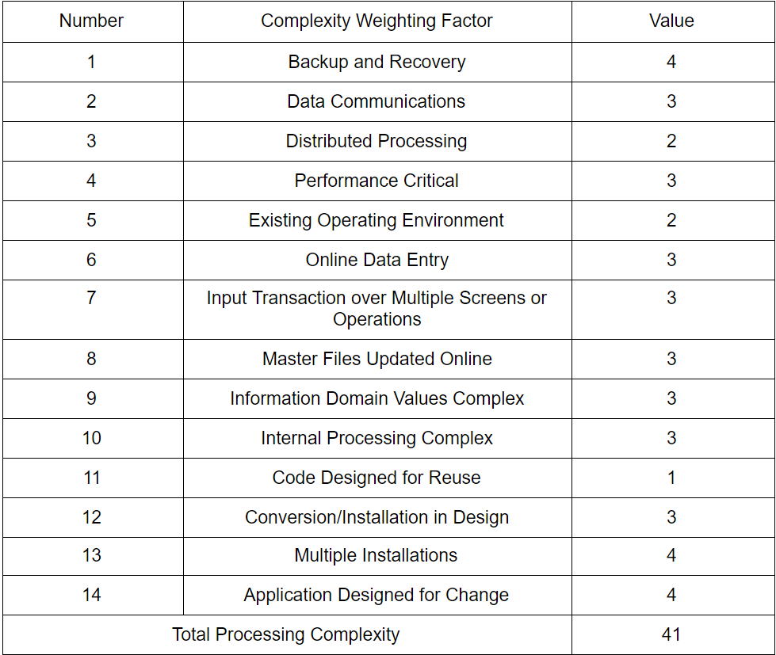
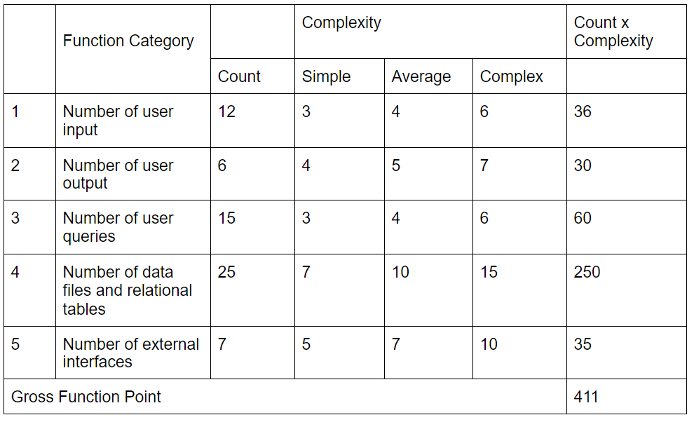
Cost Estimation (Sonia)

Slide 4
Cost Estimation (Sonia)
The Gross Function Point:
GFP = 12 * 3 + 6 * 5 + 15 * 4 + 25 * 10 + 7 * 5 = 411 FP
The Processing Complexity Adjustments:
PCA= 0.65+0.01(41)= 1.06
The Function Point Calculation:
FP = GFP * PCA = 411 * 1.06 = 436
The estimated effort is obtained as:
E = FP/productivity = 436/10 = 43.6 ≈ 44 person-weeks
If team size = 7, then project duration is:
D = E / team size = 44/7 = 6.28 ≈ 7 weeks.

Slide 5
Cost Estimation (Rolando)
Hardware products - $3,600
Software products - $1,139
Open source software reduces cost
Personnel - $50,252

Slide 6
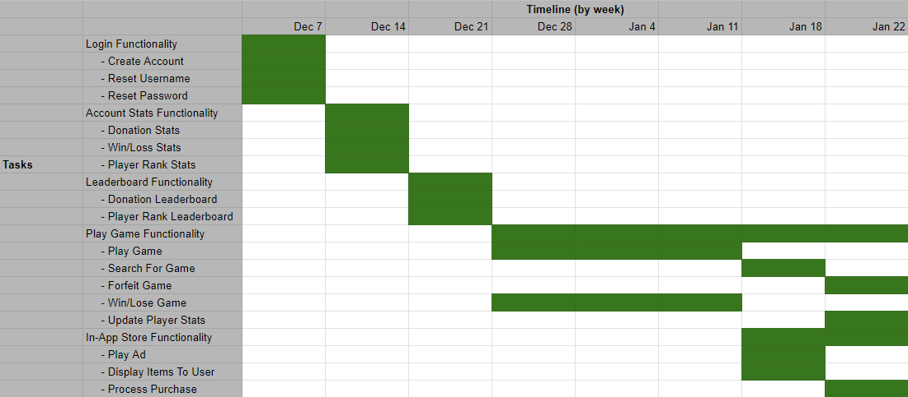
Project Timeline (Zach)

Slide 7
Functional Requirements (Sonia)
Login Access
Leaderboard Management
Profile Management
Play Chess Match
In-Game Store
Notes:
Make sure to elaborate on each point
Login Access
1. The system shall allow users to login to the system or create an account with the system using a username and password.
2. The system shall allow users with their email address to recover their username/password by sending it to their email.
Leaderboard Management
1. The system shall allow users to select highly ranked players and display their information.
2. The selected player screen shall display donation amount, rank, and any events listed that involve that player.
Profile Management
1. The system shall allow the user to display their personal game record (total wins, total losses, and donations made).
2. The system shall allow the user to add/update in-game gear purchases made from the store, such as cosmetics (chess pieces, flairs, emotes), and view in game currency spent.
Play Match
1. The system shall support 4 player chess
2. The system shall support all chess moves.
3. The system shall support in game chat while playing.
4. The system shall allow the user to search for a match based on the ELO rating.
5. Selected opponents shall have their name, icons, and cosmetics displayed when the match starts.
6. The system shall display a timer for each player during the match. If the timer ends, the player’s game is over, and the game grays out the timer and their chess pieces.
7. The system shall only count down the player’s timer when it is their turn.
8. The system shall support and display the chess move history.
9. The system shall allow users to display emotes during the match.
10. The system shall display game results when the match is over and ELO rating progress.
In Game Store
1. The system shall allow users to watch ads for in game currency.
2. The system shall allow users to purchase in game currency.
3. The system shall allow all in game purchases made by users to go towards charity.

Slide 8
Non-functional Requirements (Jim)
Product requirements
Usability
Efficiency
Performance
Space
Dependability
Security
Organizational
Environmental
Operational
Development
External
Regulatory.
Ethical
Legislative
Accounting
Safety/Security
Key Requirements:
Dependability
The game’s servers should have >99% uptime.
Less than 7 hours down per month
Regulatory
All purchases should be deterministic to avoid breaking gambling laws.
Notes:
Product requirements
Usability
The product should be available in at least one other language than English.
The product should not use color combinations that impair color-blind people’s ability to use the app.
Efficiency
Performance
load time should be less than 1s on test phone
the game should run at 60fps without going above 50% cpu utilization on test phone
Space
the game should be less than 100 MB
Dependability
Mean time to failure should be greater than 20 hours of continuous play time.
Game should automatically handle errors and restart if needed.
Game servers should have >99% uptime.
Security
Server should verify all scores to prevent fake scores filling the leaderboard.
Same with donation perks.
Organizational
Environmental
Server should be able to handle at least 1000 users on 500W of power
Operational
Administrators of the servers will have to have passwords longer than 12 characters that contain both letters and numbers. Passwords must be changed at least once every 6 months.
Development
Product should have at least 10 automatic unit tests and 10 integration tests that all pass before an update or the initial release can be deployed.
External
Regulatory.
Any purchases that obtain in-game rewards must be deterministic (no random rewards) to avoid gambling laws.
Register the company as a LLC
Ethical
The app should not harass users with notifications or guilt them into donating.
Legislative
Accounting
The app needs to log all donations in detail, including information about who donated, the amount, where the donation is going, and the date and time of the donation
Safety/Security
Payment information and records should be encrypted and not be visible to the application’s servers (write-only)

Slide 9
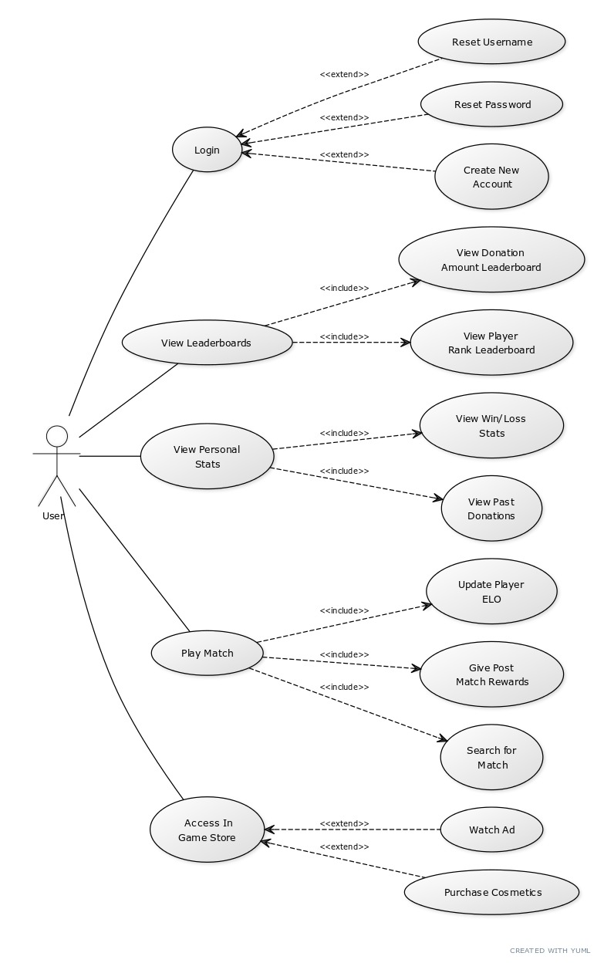
Use Case Diagram
(Zach)

Slide 10
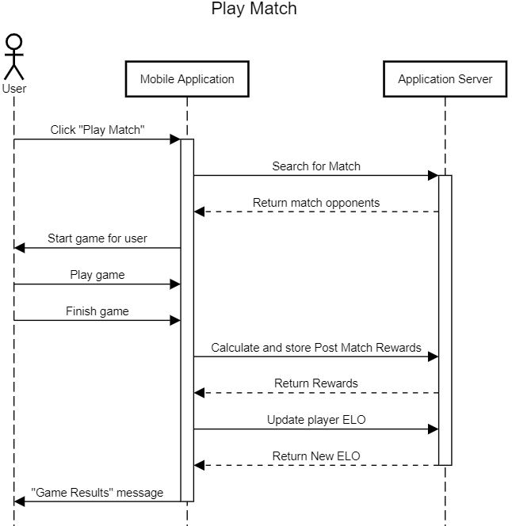
Sequence Diagram
(single representative action)
(Kenny)

Slide 11
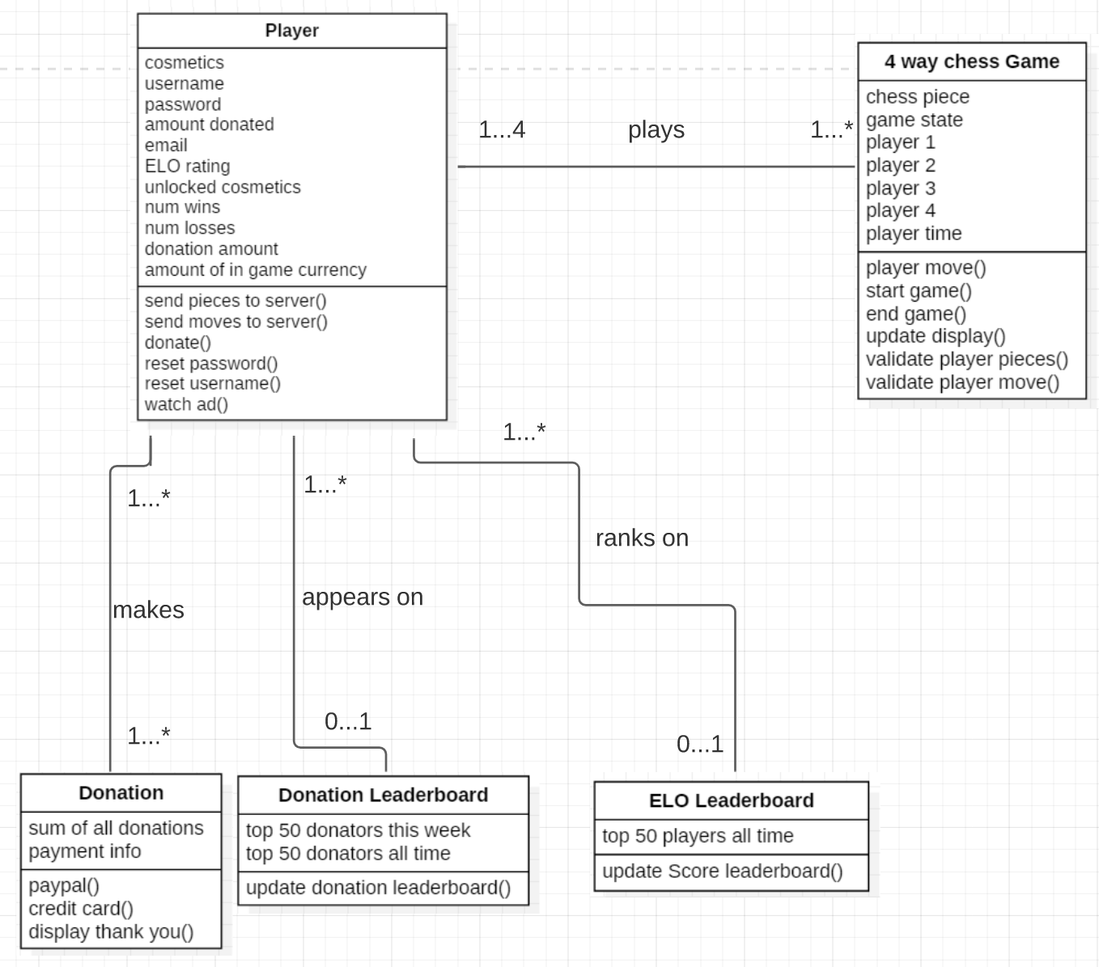
Class Diagram
(Austin)

Slide 12
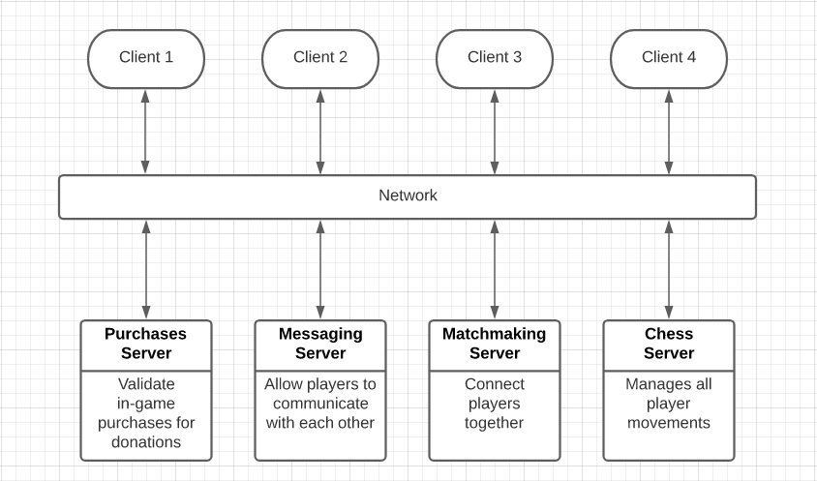
Architectural Design (Rolando)

Slide 13
User Interface Mockup (Austin)
Main Screen
Main Screen with menu open
Game Screen
Menu
Make Donation!
Make Donation!
Main Screen
4-Way Chess Game here
Donation & ELO Leaderboard
Login
Donation & ELO Leaderboard
Profile & Stats
Play Game
Store
Play Game

Slide 14
Testing Plan (Jim)
Testing Plan
We will be using black-box testing with JUnit to unit test our application.
We will also use JUnit to run a separate class as the driver for bottom-up integration testing.
We will use hand-picked alpha testers and an email lottery of beta testers for validation testing.
Example Unit Test
The example test is buying an item from the store.
There are three types of items: finite, infinite, and invalid.
We made sure all of them behaved as intended with updating the user’s balance, the user’s inventory, and the store’s stock.
Results
All tests successfully passed.
This unit test caught an error where infinite items were not being added to the store.

Slide 15
Software Process Model - Prototyping
(Junjie)
Evolutionary Model - Prototyping
developing different versions
Original version with basic functions
Multiple meetings
Further versions with essential functions and some advanced features
More ideas, less bugs

Slide 16
Comparison to Similar Designs (Kenny)
Comparative analysis
Motivational factors
Regular exercise
Impact, Charity Miles
Trivial Pursuit
Freerice
Novelty
4 Way Chess for Charity

Slide 17
Conclusion (Junjie)
Accomplished the most projected goals and constructed a workable plan
Fulfilled all personal tasks commendably
One thing might be need to change-more connection with charity organization

